Slide 1
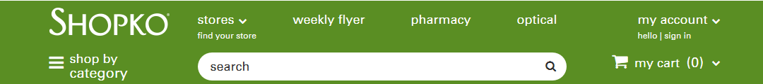

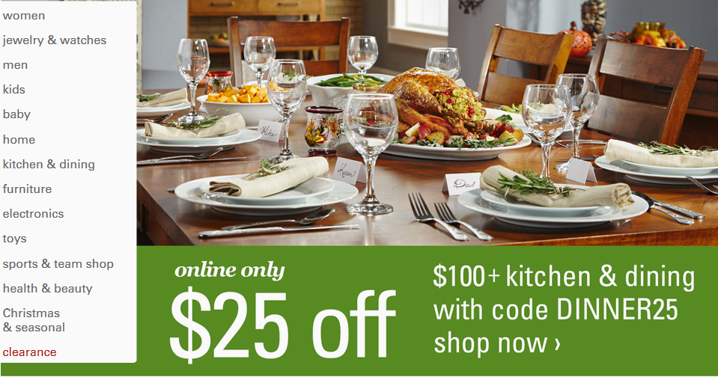
BUAN 6337 Shopko Customer Segmentation and Profiles
Group 1 Vaishali Kelkar Abhiraj Malappa Justin Pardy Chetan Patil Shreyas Sawai

Slide 2

Executive summary
Business objective
Segment analysis
Market basket
Test and learn plan
Elasticity
Marcomm Valuation
AGENDA

Slide 3
BUSINESS OBJECTIVE
SHOPKO STORES OPERATING CO., LLC is interested in segmenting buyers into distinct groups and learning about attributes, price sensitivity and insights for each segment of buyers.
EXECUTIVE SUMMARY
We divided the customers into segments, based on each segments, decided marketing strategy to improve sales, shopping experience and revenue. An increase in price of 1% will yield an increase in revenue of $44,626.

Slide 4
DATA OVERVIEW
Controllable factors- Emails sent, pricing, discounting, bundling, promotion, product placement.
Uncontrollable factors-distinct store visits, email click rate,
Purchase quantity, etc.
Un-controllable
Controllable

Slide 5
SEGMENT SIGNIFICANCE
1.
Family Fellas
2.
Farming Fasionistas
3.DIY Architects
4.
Lost World
5. Country Yuppie
60% of the revenue is generated by 22% of the customers. They are the customers to be retained.
Segment 5 has to be expanded.
Segment 4 has a significant potential for revenue improvement.

Slide 6
SEGMENTS COMPARISON
Insights:
Country Yuppies (5) best revenue generating segment. Most frequent buyers. Purchase products that are relatively lower priced. Email conversion rate is high.
Lost World (4) has most of the non-returning customers. Store visit rate is on the higher side and email response rate is lowest. This segment comprises of customers who visit stores and are unhappy.
DIY Architects (3) buy products that are relatively high priced. Customers with highest email response rate.
Farming Fashionistas (2) are the third largest segment of customers but make up the largest segment of revenue. This segment makes up the bulk of purchases in each category that they shop for
Family Fellas (1)are customers who buy expensive products. customers that who buy product online.
Number of transactions
Average price of items price
Days between transaction
Emails converted to purchases

Slide 7

SEGMENT DETAILS
Family Fellas
Most frequently purchased:
Household supplies
Food and beverages
School and Office Supplies
Cards, Books and Magazines
Home Décor
Active Shoes
Buying Habits:
51% of Customers
36% of Revenue
42 Days between visits
Average 16 items per Transaction
Average $37 per transaction
Average item price $8.90
The Family Fellas is the largest segment of customers with the second largest segment of revenue. The most interesting feature of this group is the receptiveness to email as a method of communication.

Slide 8
SEGMENT DETAILS
Family Fellas
Family Fellas
Insights:
This segment is not sensitive to price.
High engagement rate via email.
Marcomm is best spend on this segment of customers.
Recommendations:
Increase the price by 1.2%. The revenue increases by 1.6%. Beyond this point revenue decreases as sales go down.
The size of the segment compared to the revenue is much larger. We recommend bundling. Product best bundled in this segments are:
Household supplies and food and beverages
Schools supplies and cards-magazines
Providing discounts buying these products together increases sales and overall revenue.
Email strategy – Increase the number of email for this segment.

Slide 9
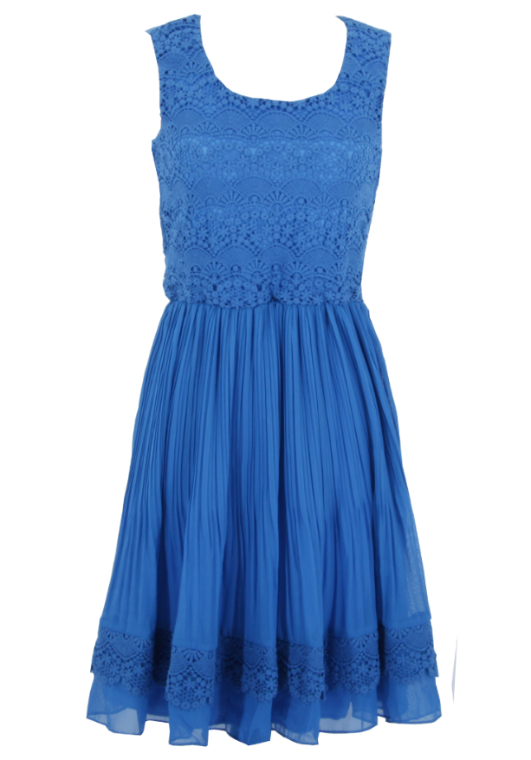
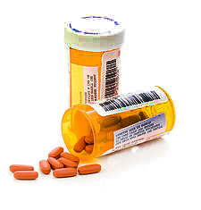
SEGMENT DETAILS
Farming Fashionistas
Most frequently purchased:
Pharmacy
Women’s accessories
Health Aids and OTC Meds
Beauty Aids
Missy apparel
Optical
Plus Apparel
Jewelry and Watches
Buying Habits:
18% of Customers
43% of Revenue
18 Days between visits
Average 47 items per Transaction
Average $46 per transaction
Average item price $7.88
The Farming Fashionistas are the third largest segment of customers but make up the largest segment of revenue. This segment makes up the bulk of purchases in each category that they shop for

Slide 10
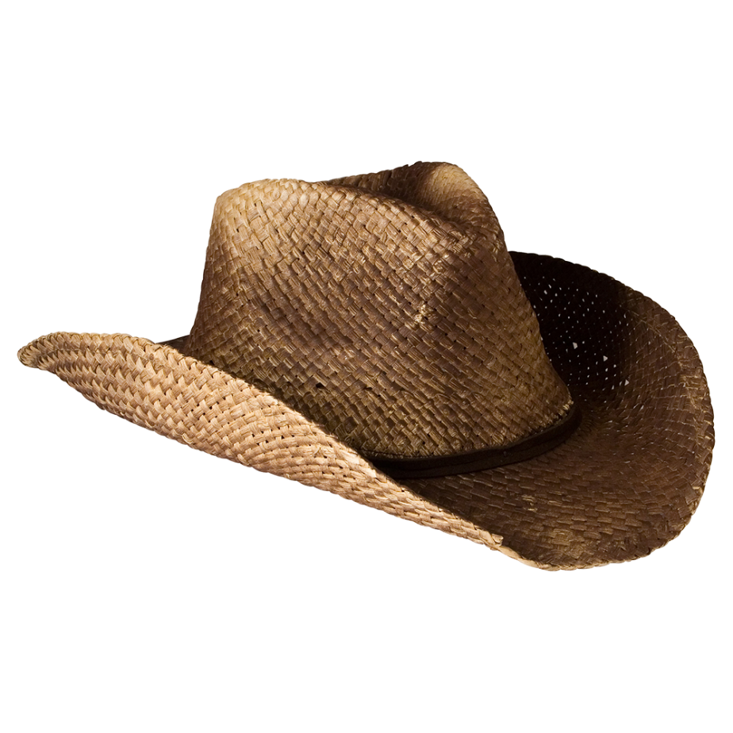
SEGMENT DETAILS
Farming Fashionistas
Farming Fashionistas
Insights:
This segment is not sensitive to price
Not sensitive to emails
Products best bundled are:
Pharmacy, health aids and OTC meds
Beauty aids, jewelry watches
Recommendations:
Increasing price by 1.7%.
Provide loyalty points
In store credits
Free product delivery
Pre-sale offers for these members
Provide discounts on the suggested product bundles
Emails campaign is not significant. Reduce the number of emails send.

Slide 11
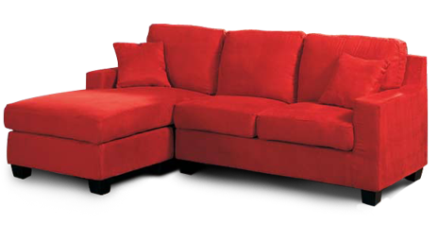
SEGMENT DETAILS
DIY Architect
Most frequently purchased:
Furniture
Patio-furniture
Trim a tree
Lawn Garden
Household supplies
Beverages
Buying Habits:
51% of Customers
36% of Revenue
42 Days between visits
Average 16 items per Transaction
Average $37 per transaction
Average item price $8.90
Buy products that are relatively high priced. Customers with highest email response rate. Mostly shop online

Slide 12
SEGMENT DETAILS
DIY Architect
Insights:
Sensitive to price
Marcomm is best spent on this segment of customers.
Products best bundled are:
Kitchen table top and lawn garden
Trim tree and lawn garden
Recommendations:
Provide discounts to increase sales and overall revenue.
Prove additional discount for bundled products
Place lawn garden and kitchen table top together
Increasing the number of emails by 1% increases revenue by 0.06%
Provide discounts on online shopping

Slide 13



SEGMENT DETAILS
Lost World
Most frequently purchased:
Pet Supplies
Unallocated
Furniture
Jewelry and Watches
Patio Furniture
Plus Apparel
Buying Habits:
27% of Customers
5% of Revenue
75 Days between visits
Average 3 items per Transaction
Average $43 per transaction
Average item price $10.41
The Lost World are a segment with unrealized potential. They are 27% of the customers but only 5% of the revenue and only visit the store once every three or so months.

Slide 14


SEGMENT DETAILS
Lost World
Insights:
Not sensitive to price
Email Marcomm is not particularly effective.
No strong bundling of products for this group.
Recommendations:
Combination of increasing price or decrease coupons on products not purchased heavily by other segments.
Personally contact a sample of these customer for a focus group to learn more about them given that they don’t easily classify themselves via purchase behavior.
Reduce emails sent to these customers.
Investigate location of customers in relation to closest store, a physical catalog with mail-order may increase purchases if increasing store visits is not an option.

Slide 15
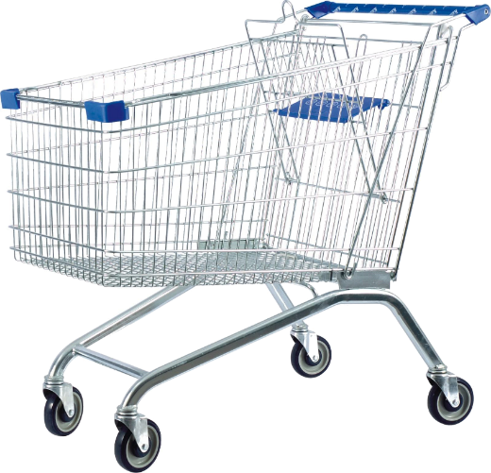
SEGMENT DETAILS
Country Yuppies
Most frequently purchased:
Food beverages
Consumer electronics
Home organization
Toys
Baby personal care
Women accessories
Buying Habits:
2% of Customers
13% of Revenue
9 Days between visits
Average 101 items per Transaction
Average $58 per transaction
Average item price $7.60
The Country Yuppies is the smallest segment of customers with the third largest segment of revenue with a revenue to customer count ratio greater than 6:1. The most interesting feature of this group is frequency and size of purchases. These customers likely live in the towns of Shopko stores, are able to visit frequently and have small families.

Slide 16
SEGMENT DETAILS
Country Yuppies
Country Yuppies
Insights:
Not sensitive to price
Segment with highest profit
Good email response rate
Products best bundled are:
Consumer electronics and home organization
School/ Office Supplies and toys
Recommendations:
Increase price of products.
With increase of 5 emails sent to each customer the revenue for this segment is increased by .006%
Increase discounts on the bundled products.
Find customers in other segments or general population with similar purchases and target with direct mail featuring the products purchased by this segment.

Slide 17

Test Plan
Online shoppers
Test marketing hypothesis for each
Store visitors
Test strategies for test group of each online and store visitors and apply lessons learned to improve revenue
Basically two types of customer method of buying: Online shoppers and store visitors
Test and Control groups can be made for each to test the customer behavior
Lessons learned may be applied to improve revenue

